Slide 1
Human Foods Program

Slide 2
Toxicokinetic Chemical Simulator (ToCS): A Graphical User Interface for High-Throughput Chemical Analysis
Kristen Leonard Contractor Office of Scientific Coordination and Computational Sciences (OSCCS)
October XX, 2025

Slide 3
Session I: Introduction to ToCS

Slide 4
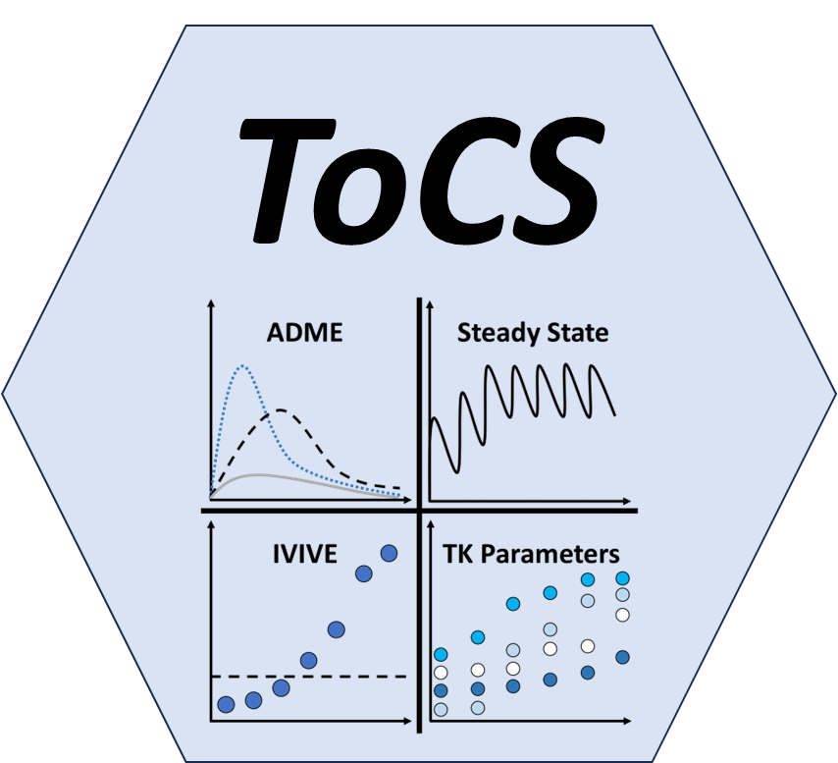
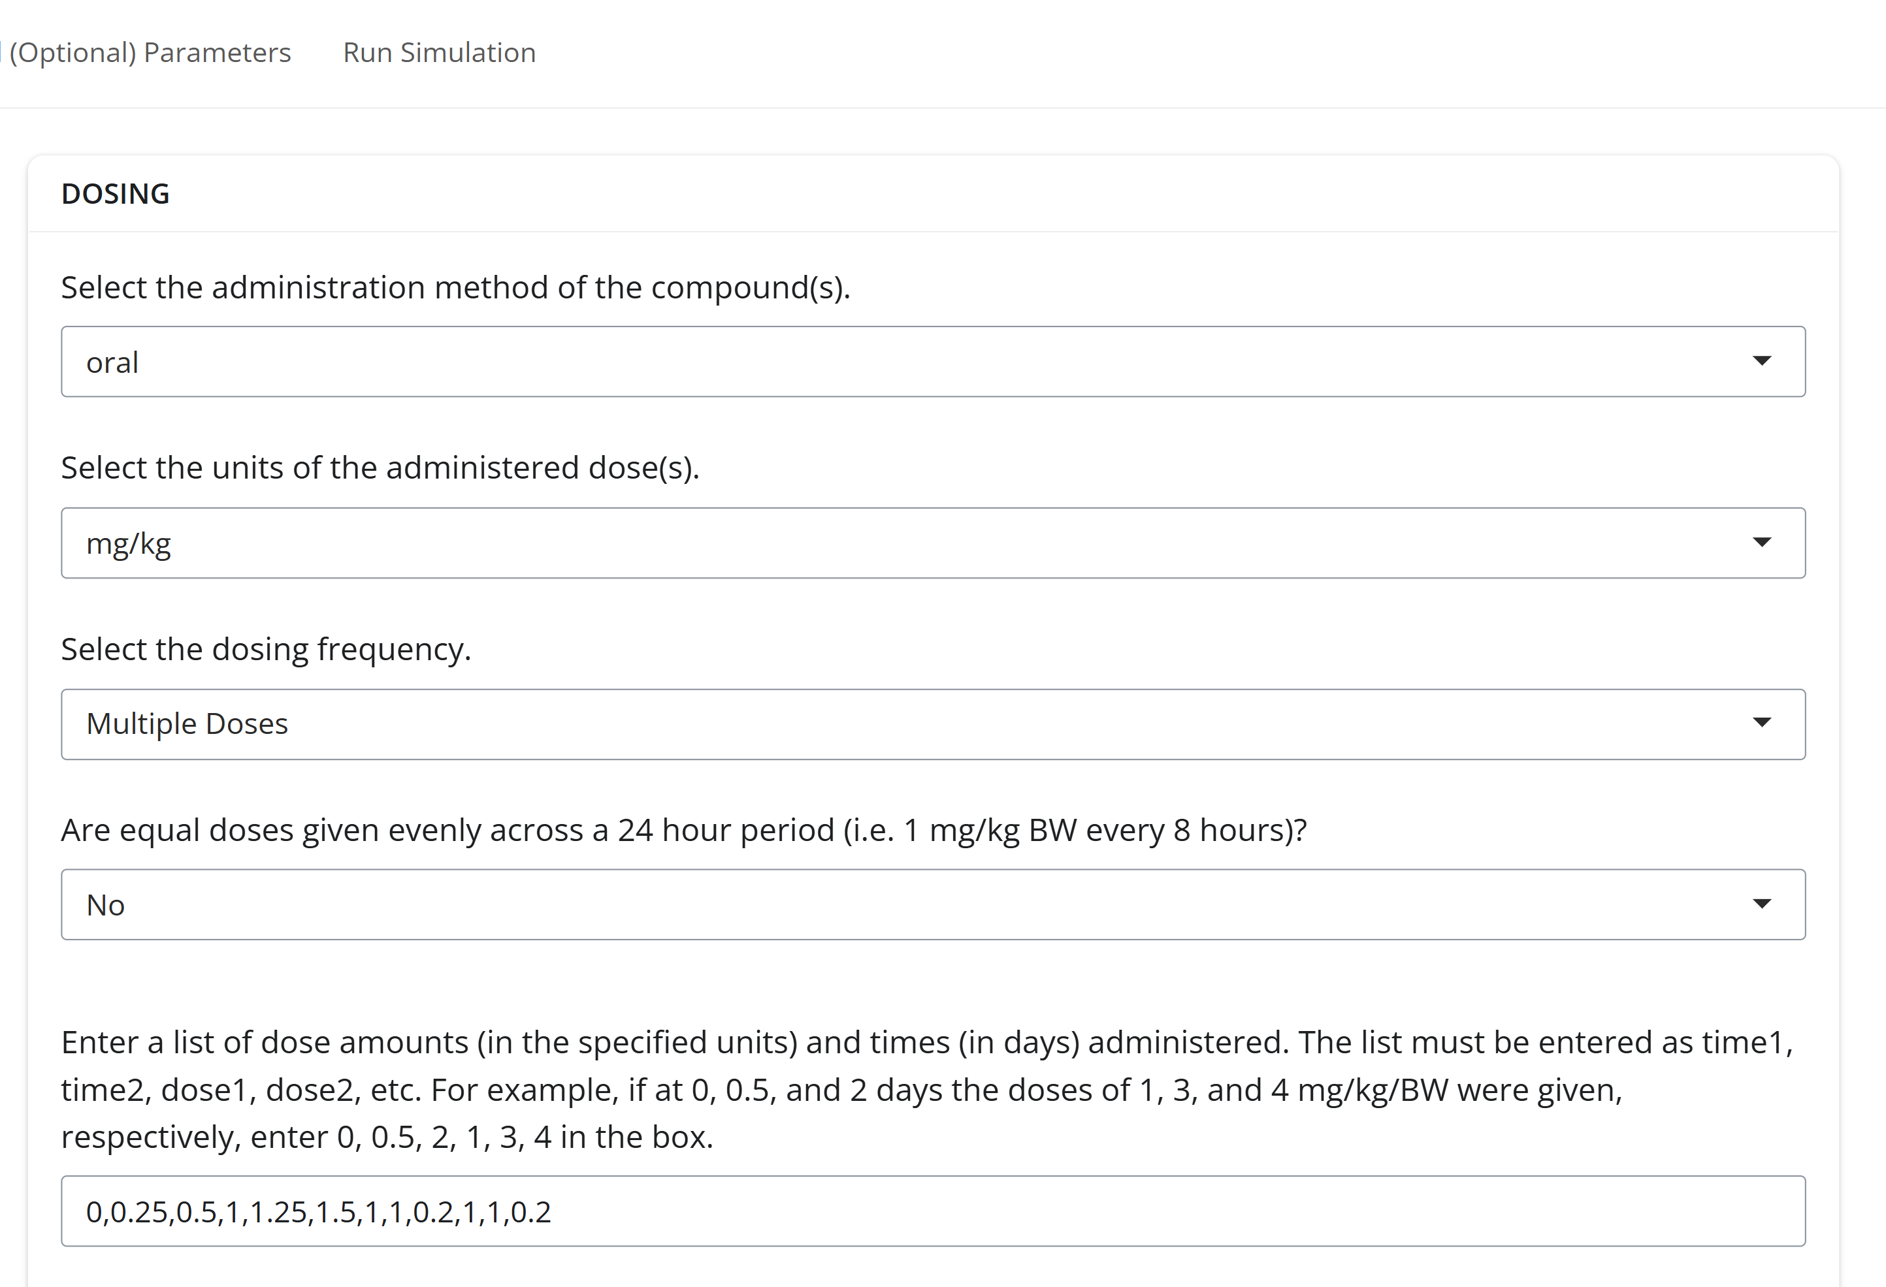
What is ToCS?
A graphical user interface (GUI) that uses computational toxicology software (the httk R package developed by the U.S. EPA) to make high-throughput chemical predictions
Easy-to-use, no programming required
Predict ADME profiles and characteristics, prioritize chemicals, and generate TK parameters

Slide 5
Purpose
High throughput chemical evaluation at beginning of studies and for prioritization; characterization of chemicals
Obtain parameters to use in other models

Slide 6
ToCS Outputs
Concentration-Time Profiles Module ADME time course data (Amounts and concentrations over time) Summary statistics (Tmax, Cmax, and AUC) | Steady State Concentrations Module Analytical steady state in desired concentration/tissue Estimate of the time (days) it takes to reach steady state behavior following constant oral dosing
In Vitro to In Vivo Extrapolation (IVIVE) Module OEDs (the external dose needed to produce the internal bioactive conc.) compared with exposure data (if provided by the user) BERs if exposure data is provided by the user | Parameter Calculations Module Toxicokinetic parameters (half-life, total plasma clearance, elimination rate, volume of distribution) Partition coefficients in different tissues
Abbreviations: ADME – absorption, distribution, metabolism, excretion; Cmax – maximal concentration; Tmax – time to Cmax; AUC – area under the curve; OED – oral equivalent dose; BER – bioactivity exposure ratio

Slide 7
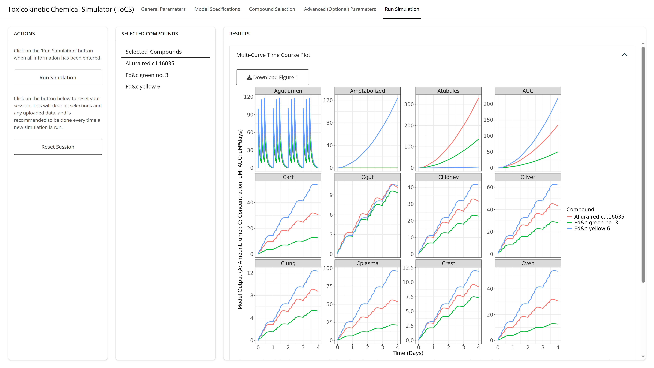
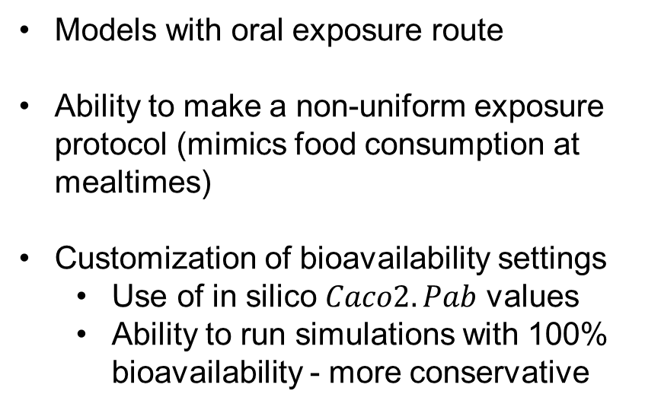
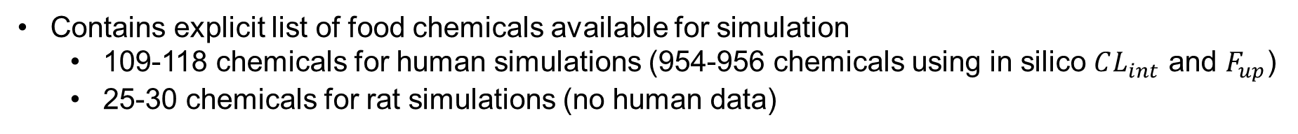
Food Relevant Features
Models with oral exposure route
Ability to make a non-uniform exposure protocol (mimics food consumption at mealtimes)
Customization of bioavailability settings
Use of in silico $Caco2.Pab$ values
Ability to run simulations with 100% bioavailability - more conservative
Contains explicit list of food chemicals available for simulation
109-118 chemicals for human simulations (954-956 chemicals using in silico $CL_{int}$ and $F_{up}$)
25-30 chemicals for rat simulations (no human data)

Slide 8
How does ToCS compare to other GUIs?
Feature | ToCS | ICE* |  | Feature | ToCS | ICE*
httk software version | 2.7.0 | 2.2.2 |  | Analytical SS concentrations | Plasma and all tissues | Plasma only
Species | Human, rat, mouse, dog, rabbit | Human, rat |  | Estimates days to plasma SS | Yes | No
Food chemical subset | Yes | No |  | OED calculation | Plasma and all tissues | Plasma only
Loads in silico caco-2 permeability values | Yes | No |  | Convert nominal in vitro bioactive conc to free conc | Yes | No
Customize parameter calculation methods | Yes | No |  | OED quantile returned | User’s choice | 5% and 50%
Dosing routes | Oral | Oral, iv, inhalation |  | Option to view all OED samples | Yes | No
ADME dosing | Single, evenly recurring, and non-uniform | Single, evenly recurring |  | Built-in bioactivity data | No | Yes
Inclusion of full pregnancy model | Yes | No |  | Bioactivity exposure ratio (BER) calculation | Yes | No
AUC and Tmax calculated for plasma and all tissues | Yes | Plasma only |  | Volume of distribution, elimination rate, total plasma clearance, and partition coefficient calculations | Yes | No
*Integrated Chemical Environment (https://ice.ntp.niehs.nih.gov/)

Slide 9
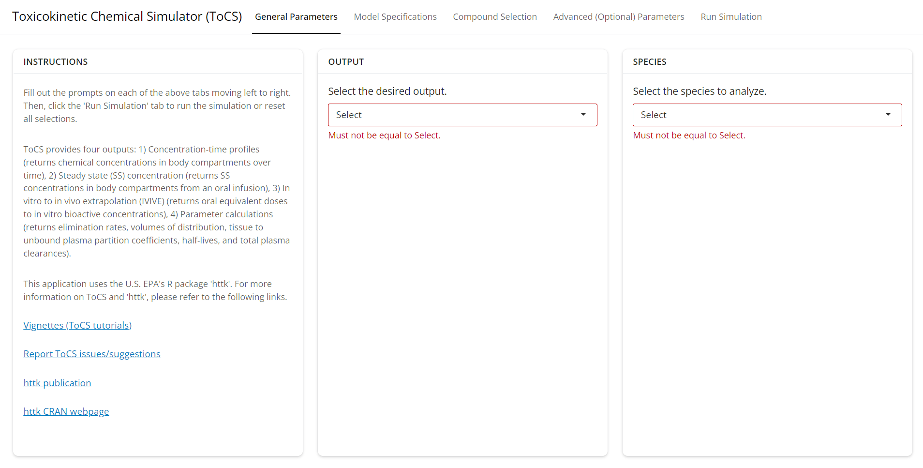
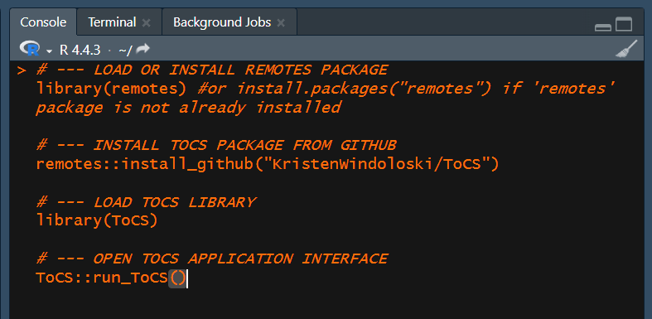
How to Access the ToCS Interface
Web Application
pub-connect.foodsafetyrisk.org/tocs
No programming needed
R Package
Install in R from the ToCS GitHub
Some programming needed

Slide 10
Interface Structure
Select model conditions
Select model solver parameters
Select bioavailability parameters
Specify output parameters
Select model and model parameters
Select in silico parameter preference
Specify dosing scenario/parameters
Resources
Select module
Select species
Select preloaded compounds
Upload new compounds
Upload other data
Run simulation button
Outputted plots and tables

Slide 11
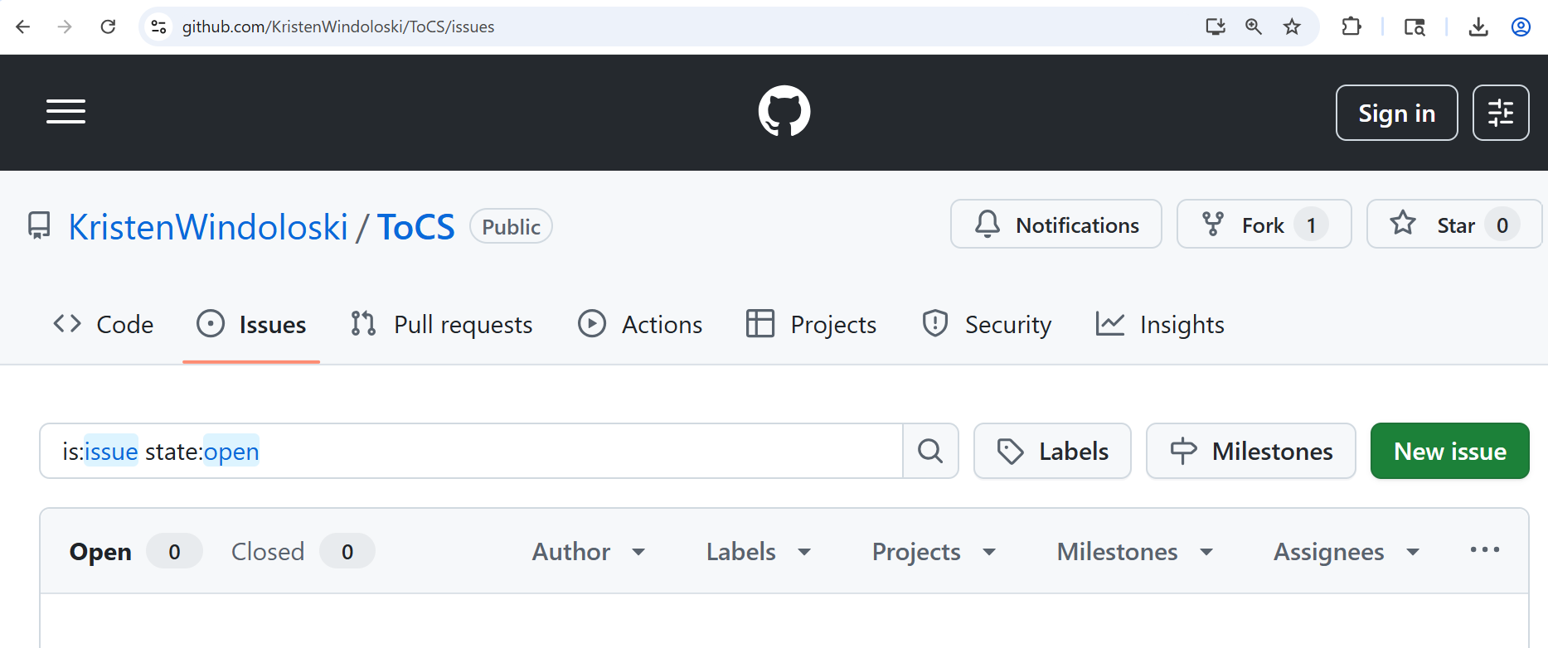
Getting Help and Reporting Issues
README file (https://github.com/KristenWindoloski/ToCS)
Vignettes (https://github.com/KristenWindoloski/ToCS/tree/main/vignettes)
Click the “New Issue” button if any bugs or errors arise when using ToCS

Slide 12
An Overview of httk and its Models

Slide 13
The httk R package
Contains generalized mathematical models (same structure for each chemical, but use of chemical-specific parameters
Chemical specific parameters include:
In vitro intrinsic hepatic clearance
In vitro fraction unbound in plasma
Molecular weight
Octanol water partition coefficient
Many others…

Slide 14
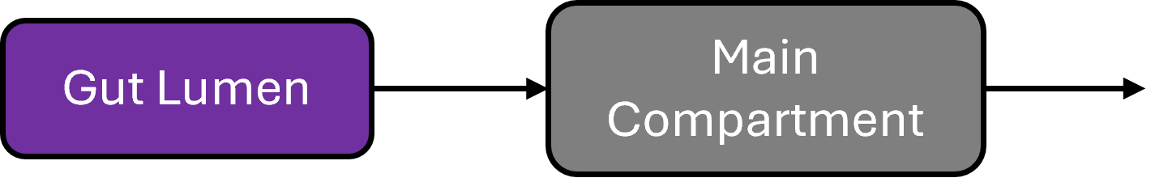
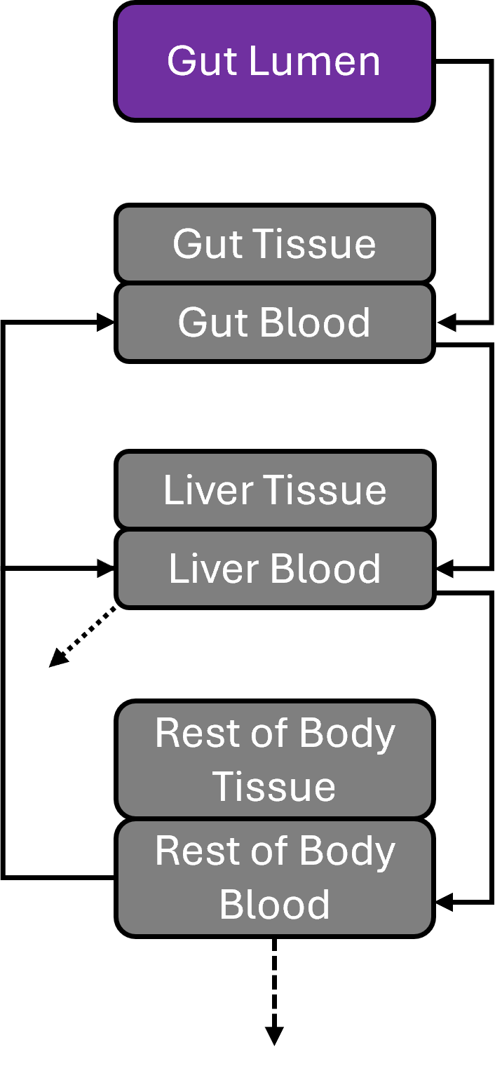
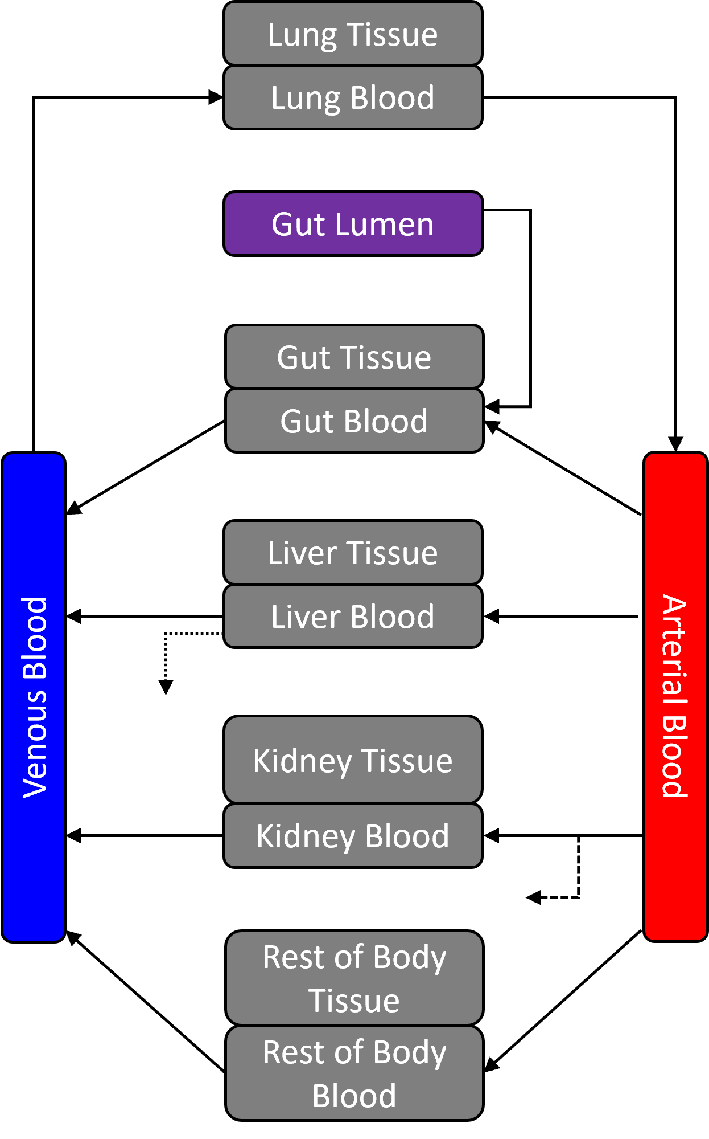
httk Models
1compartment
3compartment
pbtk
Hepatic clearance
Passive glomerular
filtration

Slide 15
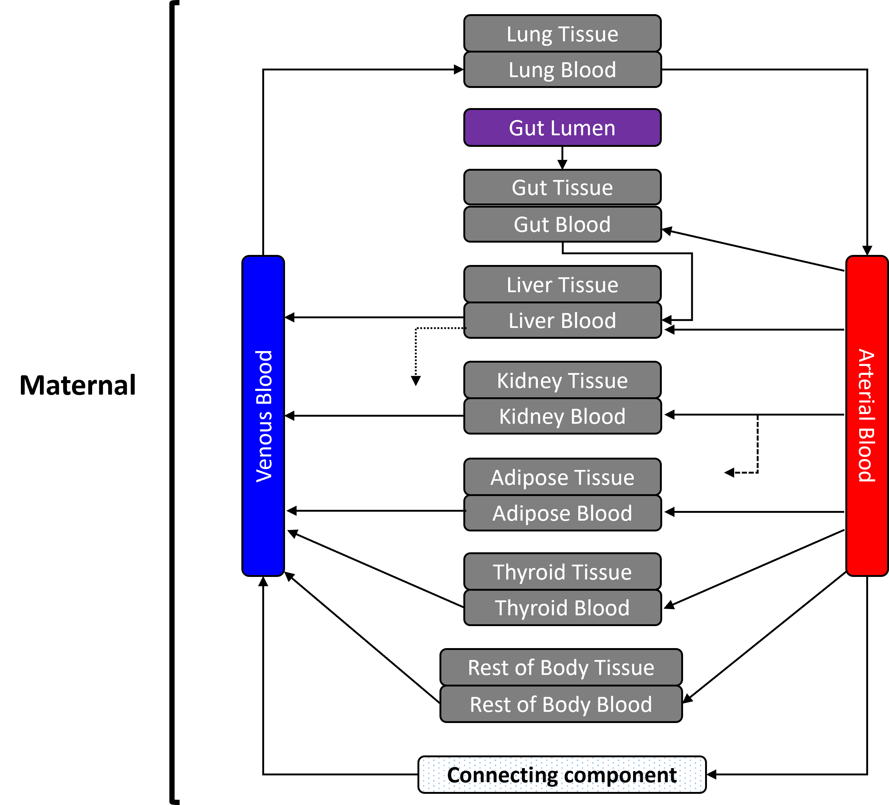
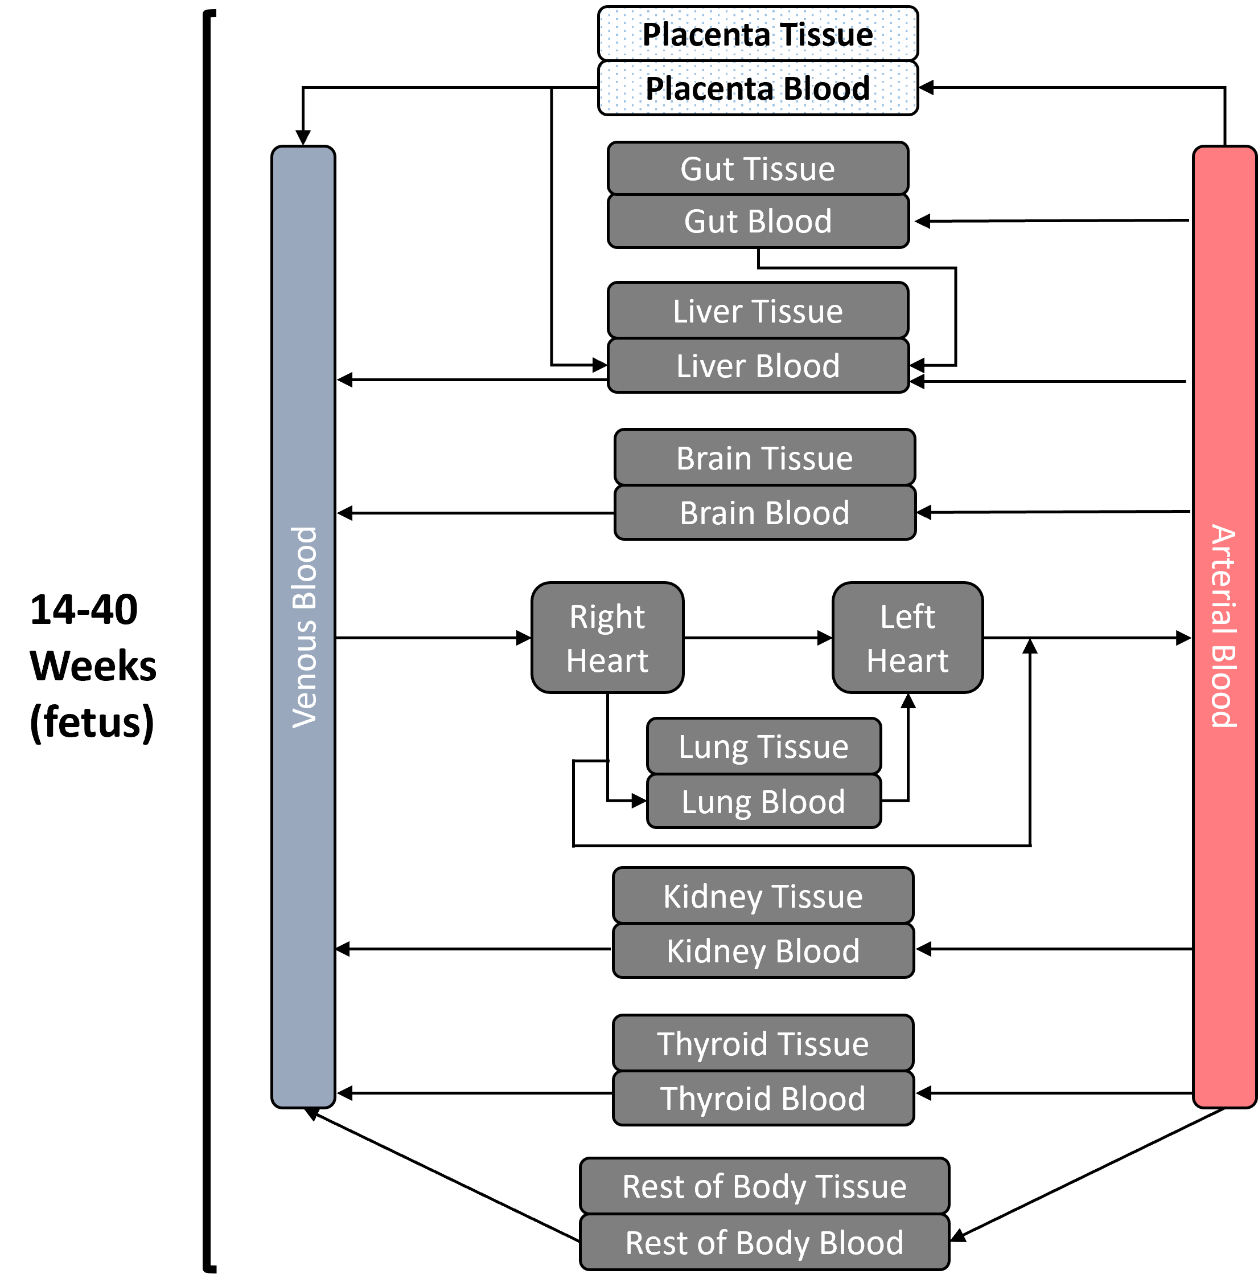
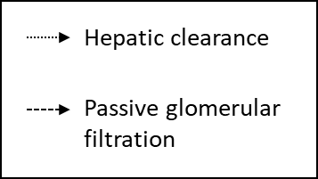
httk Models
fetal_pbtk model (2nd and 3rd trimesters)
Fetal
Placenta Tissue
Placenta Blood

Slide 16
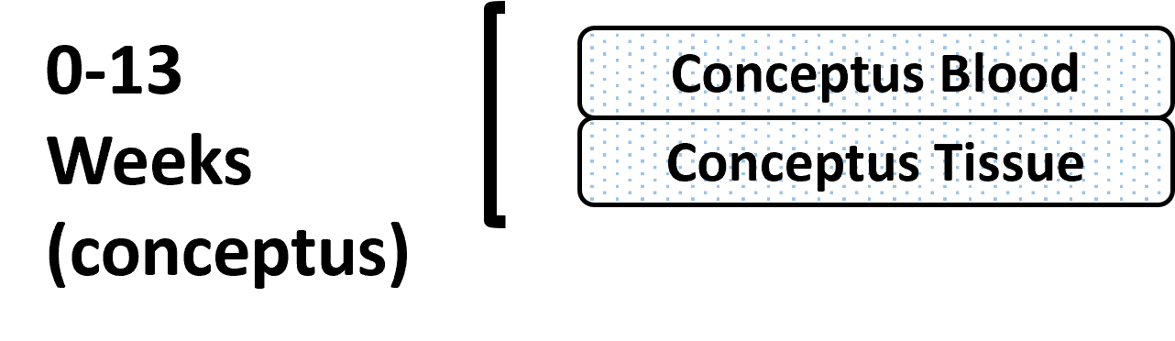
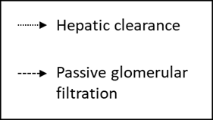
httk Models
Full_pregnancy model

Slide 17
Additional Information on httk
Websites
https://github.com/USEPA/CompTox-ExpoCast-httk
https://cran.r-project.org/web/packages/httk/index.html
Publications
Breen, M., Ring, C.L., Kreutz, A., Goldsmith, M., and Wambaugh, J.F. (2021). High-throughput PBTK models for in vitro to in vivo extrapolation. Expert Opin. Drug Metab. Toxicol. 17(8), 903–921. doi: 10.1080/17425255.2021.1935867.
Breen, M., Wambaugh, J.F., Bernstein, A., Sfeir, M., and Ring, C.L. (2022). Simulating toxicokinetic variability to identify susceptible and highly exposed populations. J. Expo. Sci. Environ. Epidemiol. 32(6), 855-863. doi: 10.1038/s41370-022-00491-0.
Kapraun, D.F., Sfeir, M., Pearce, R.G., Davidson-Fritz, S.E., Lumen, A., Dallmann, A., et al. (2022). Evaluation of a rapid, generic human gestational dose model. Reprod. Toxicol. 113, 172-188. doi: 10.1016/j.reprotox.2022.09.004.
Pearce, R.G., Setzer, R.W., Strope, C.L., Wambaugh, J.F., and Sipes, N.S. (2017). httk: R package for high-throughput toxicokinetics. J. Stat. Softw. 79(4), 1-26. doi: 10.18637/jss.v079.i04.
Truong, K.T., Wambaugh, J.F., Kapraun, D.F., Davidson-Fritz, S.E., Eytcheson, S., Judson, R.S., et al. (2025). Interpretation of thyroid-relevant bioactivity data for comparison to in vivo exposures: A prioritization approach for putative chemical inhibitors of in vitro deiodinase activity. Toxicology 515, 154157. doi: 10.1016/j.tox.2025.154157.
Wambaugh, J.F., Wetmore, B.A., Ring, C.L., Nicolas, C.I., Pearce, R.G., Honda, G.S., et al. (2019). Assessing toxicokinetic uncertainty and variability in risk prioritization. Toxicol. Sci. 172(2), 235-251. doi: 10.1093/toxsci/kfz205.

Slide 18
Chemical Selection

Slide 19
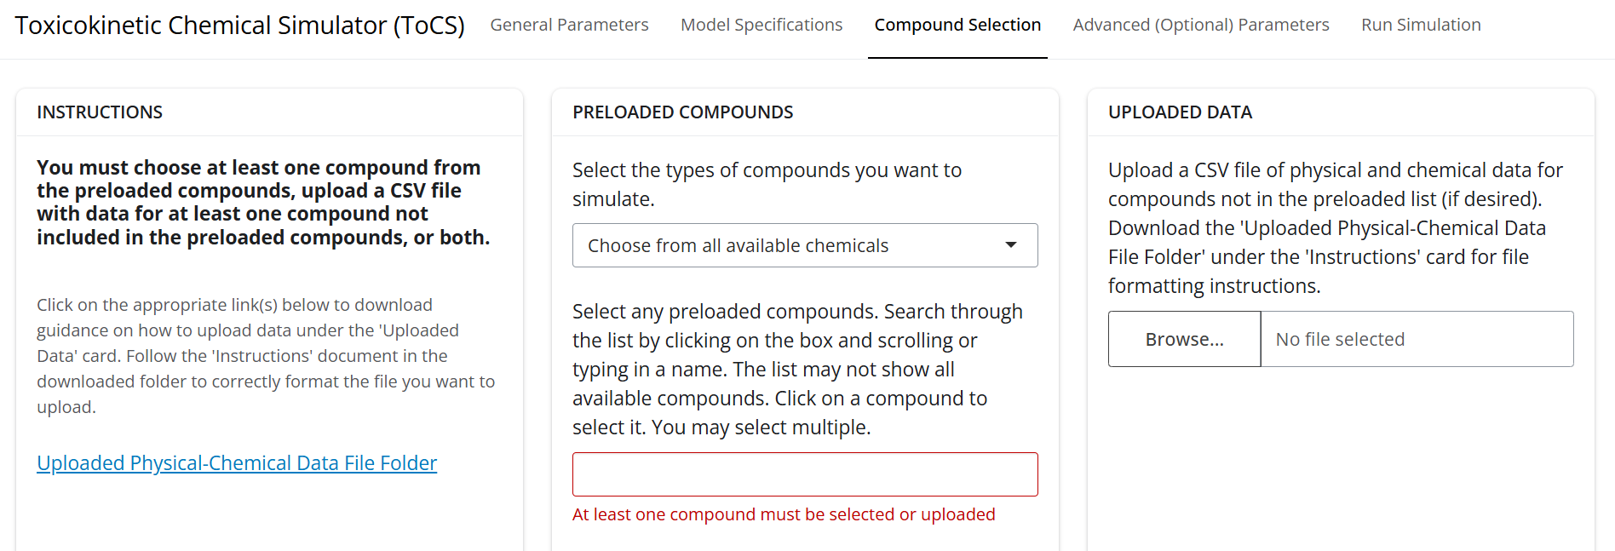
Compound Selection Interface
Downloadable folder detailing how to upload physicochemical data to simulate new compounds
Drop-down list of chemicals with data already preloaded into httk, contains only compounds with adequate data for simulation
Click here to upload a CSV file of physicochemical data for chemicals not available in the preloaded drop-down list

Slide 20
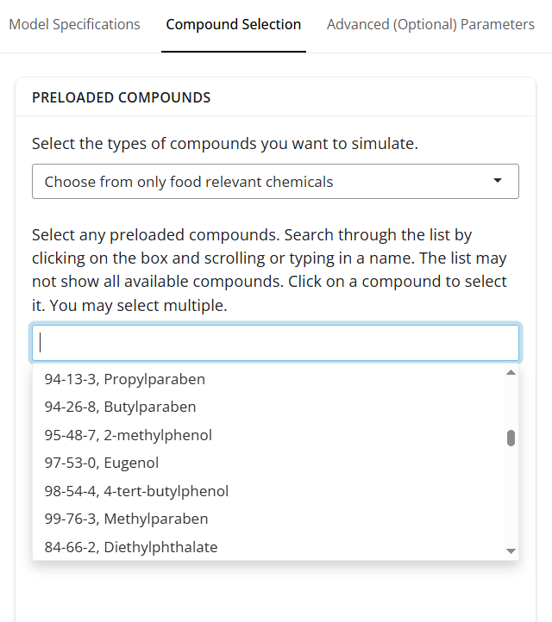
Compound Selection: Preloaded Drop-Down List
Contains compounds with data already in httk
Search the drop-down list by:
Typing in the CAS number (recommended)
Typing in the compound name
Scrolling the list (all compounds are not visible)

Slide 21
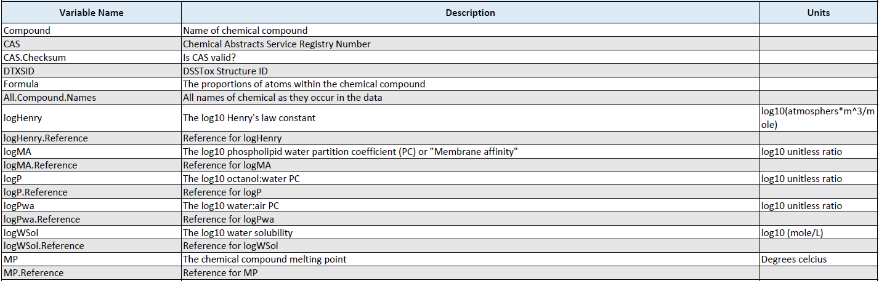
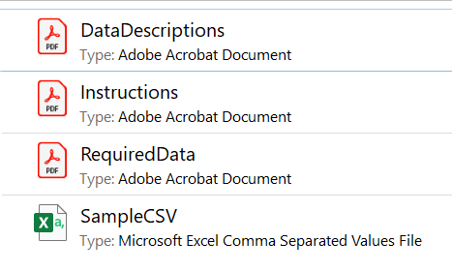
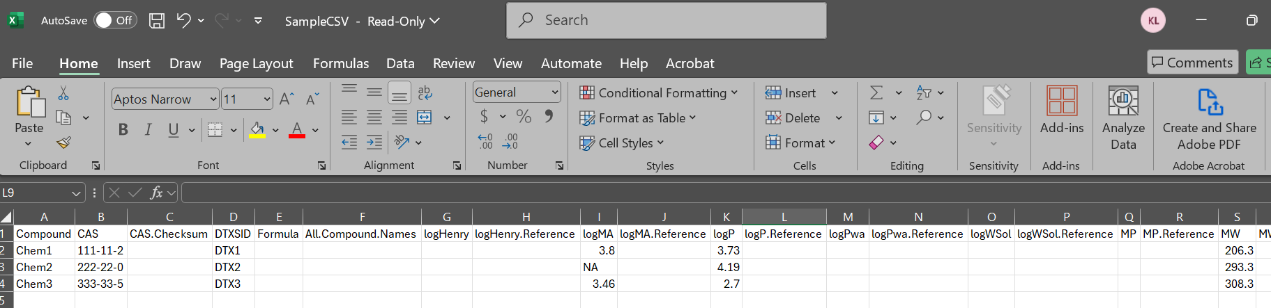
Compound Selection: Upload Your Own Compounds

Slide 22
Compound Selection: Uploaded Data
Required Data
Compound name
CAS number
DTXSID
Molecular weight
Log10 octanol:water partition coefficient
In vitro intrinsic hepatic clearance
In vitro fraction unbound in presence of plasma proteins
Optional Data
Log10 Henry’s law constant
Log10 phospholipid water partition coefficient
Log10 water air partition coefficient
Log10 water solubility
Melting point
Hydrogen acceptor equilibria concentration
Hydrogen donor equilibria concentration
In vivo measured fractional systemic bioavailability of an oral dose
Caco‐2 apical‐to‐basal membrane permeability
Probability that there is no clearance observed
In vivo fraction of oral dose absorbed and entering gut lumen
In vivo fraction of oral dose surviving first pass metabolism in the gut
In vivo fraction of oral dose surviving first pass hepatic clearance
Ratio of blood to plasma chemical concentration

Slide 23
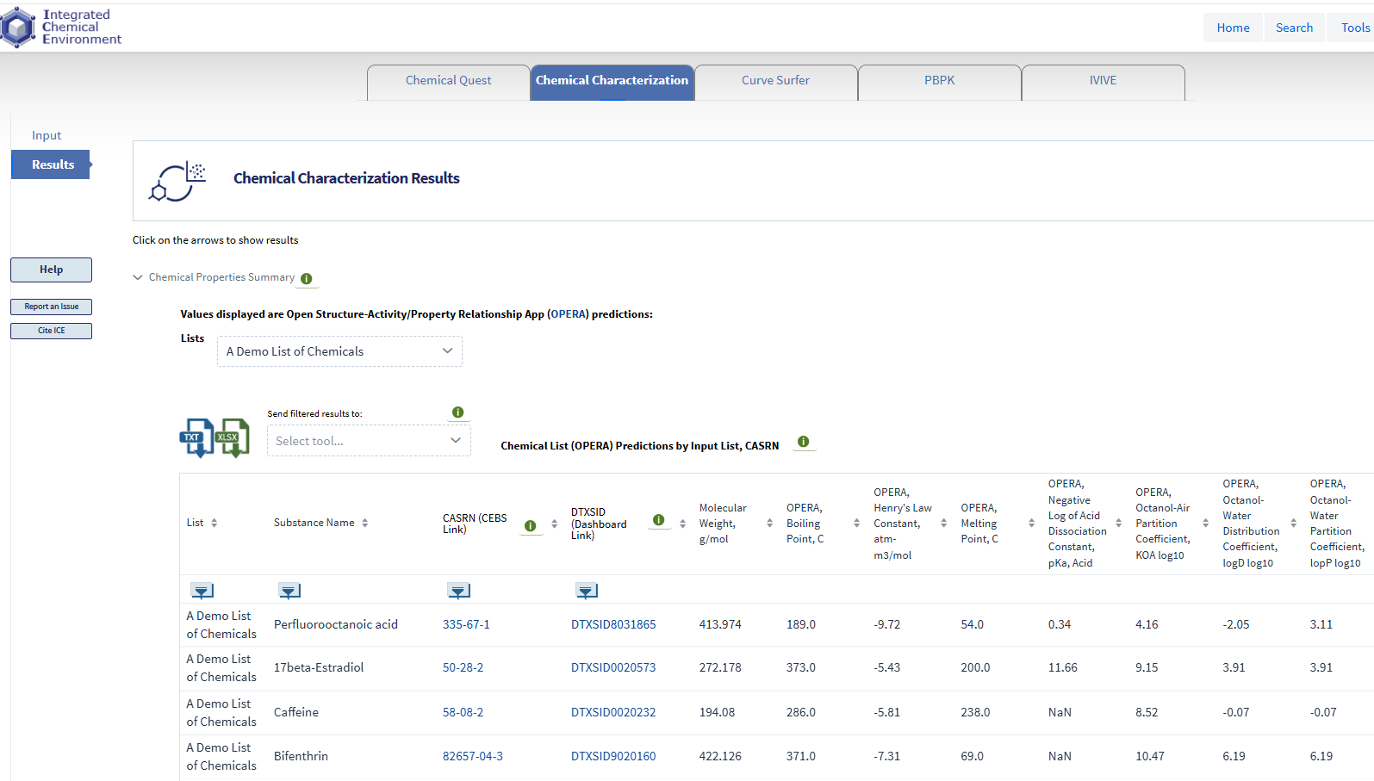
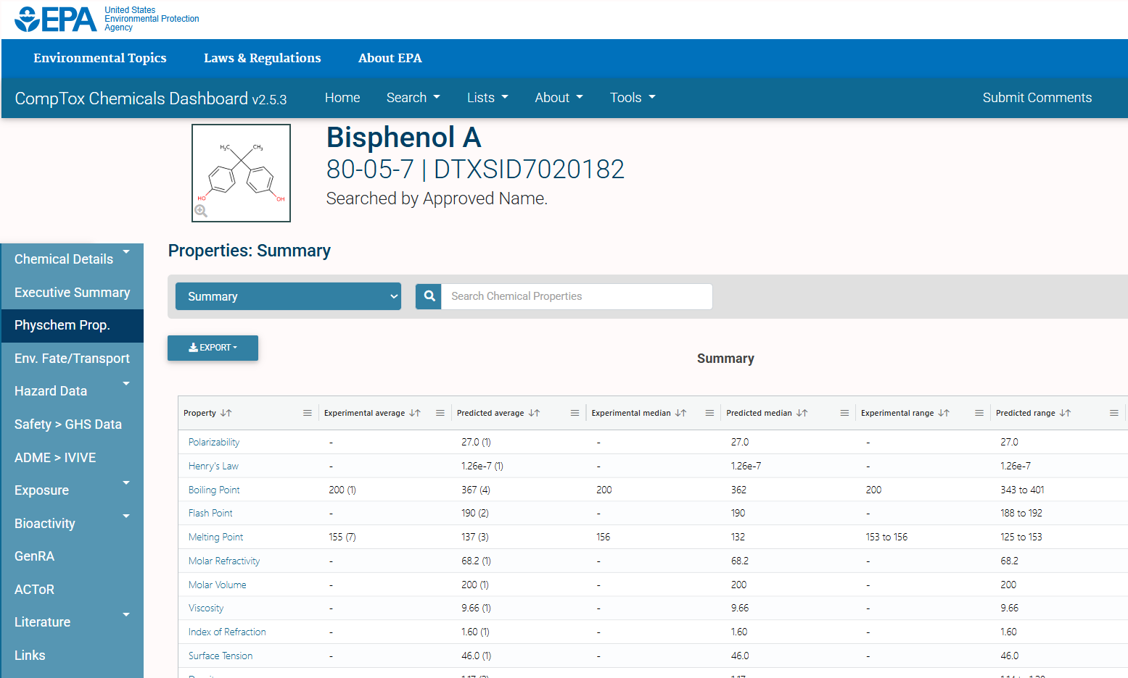
Where Can I Find the Chemical Data?
NTP’s Integrated Chemical Environment (ICE)
(https://ice.ntp.niehs.nih.gov/)
EPA’s CompTox Chemicals Dashboard (https://comptox.epa.gov/dashboard)

Slide 24
Demo: Uploading Chemical Data
Chemical XXX

Slide 25
Demo: Uploading Chemical Data
Download physicochemical data folder
Copy SampleCSV file to a new file to edit
Search for chemical data within EPA’s CompTox Dashboard
Update appropriate fields in new CSV file
Save CSV file and upload within ToCS interface

Slide 26
Session II: Concentration-Time Profiles Module

Slide 27
Outline
Explain different dosing scenarios
Model states (abbreviations)

Slide 28
PBTK Modeling Background

Slide 29
Concentration-Time Profile Module Inputs
Required:
Species and species preferences (if applicable)
Model selection
Number of simulation days
In silico parameter preference
Dosing method, units, frequency, and amount
Chemicals to simulate
Optional:
Initial compartment values
Bioavailability settings
Model solver settings
Model calculation preferences involving the hepatic clearance, fraction unbound in plasma, ratio of chemical concentration in blood to plasma, and partition coefficients

Slide 30
Example 1 Scenario
Goal:
Obtain the concentration-time profiles of five indirect food additives during all three trimesters of human pregnancy
Cyclohexylamine (CAS: 108-91-8)
Triethanolamine (CAS: 102-71-6)
Ethyl methacrylate (CAS: 80-09-1)
Ethanolamine (CAS: 141-43-5)
Octhilinone (CAS: 26530-20-1)
Use the available in silico parameters
Orally consumes 0.5 mg/kg BW of each chemical twice a day (every 12 hours), every day for the entire pregnancy

Slide 31
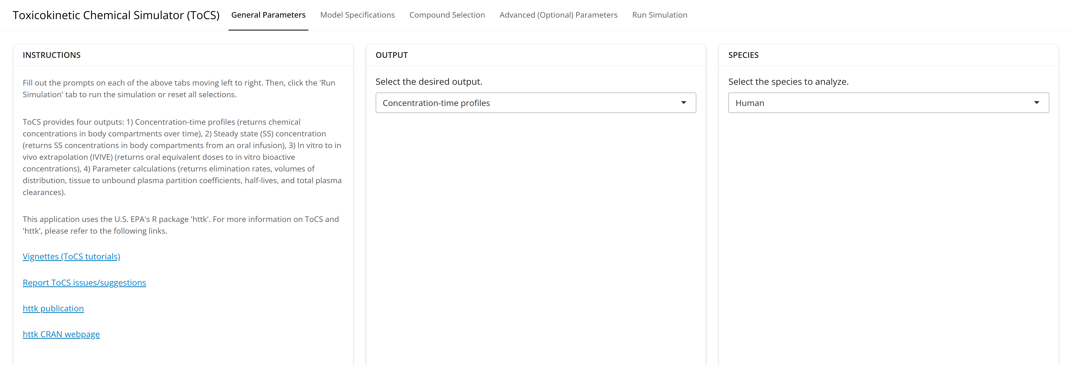
Example 1: General Parameters Tab

Slide 32
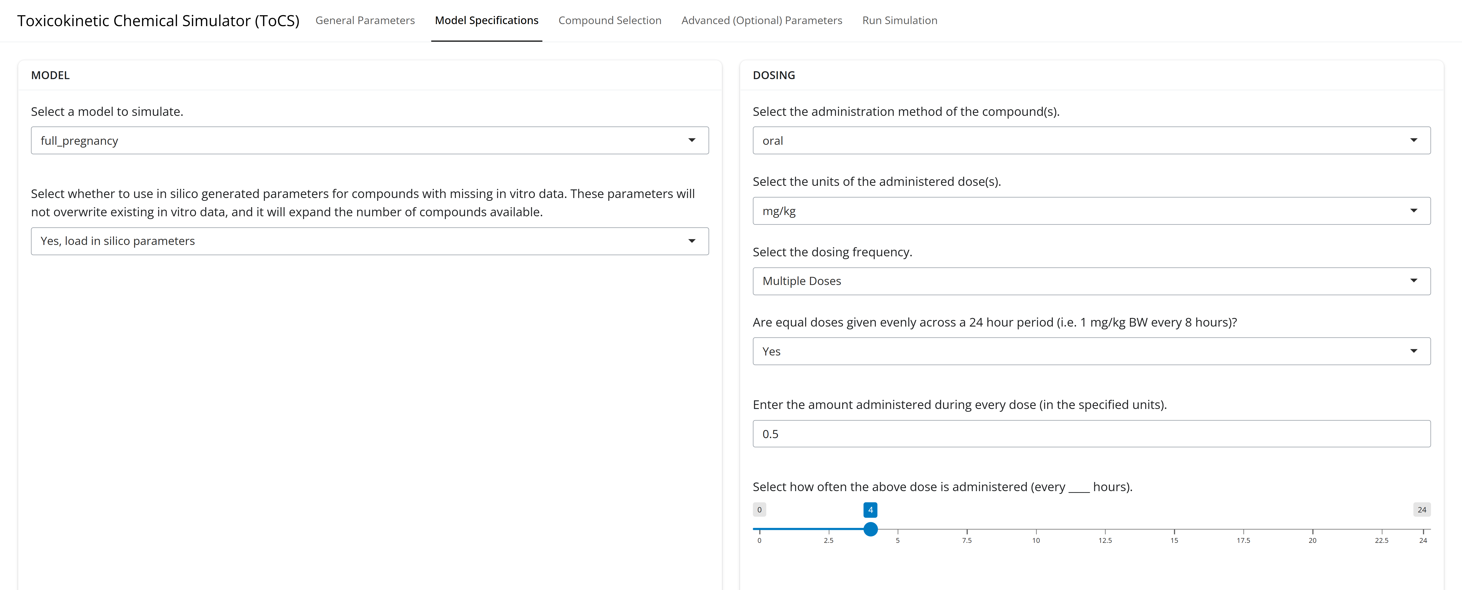
Example 1: Model Specifications Tab

Slide 33
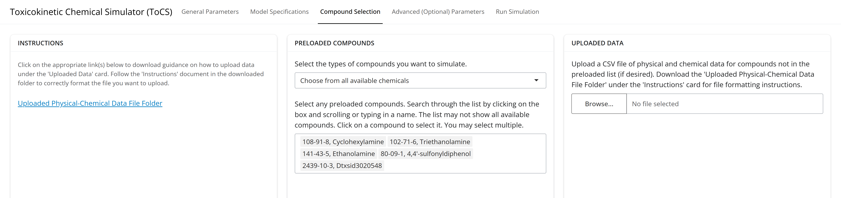
Example 1: Compound Selection Tab

Slide 34
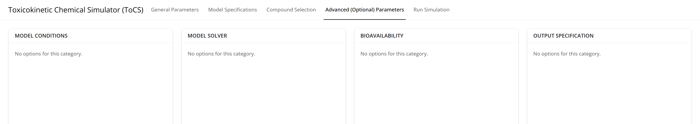
Example 1: Advanced Parameters Tab

Slide 35
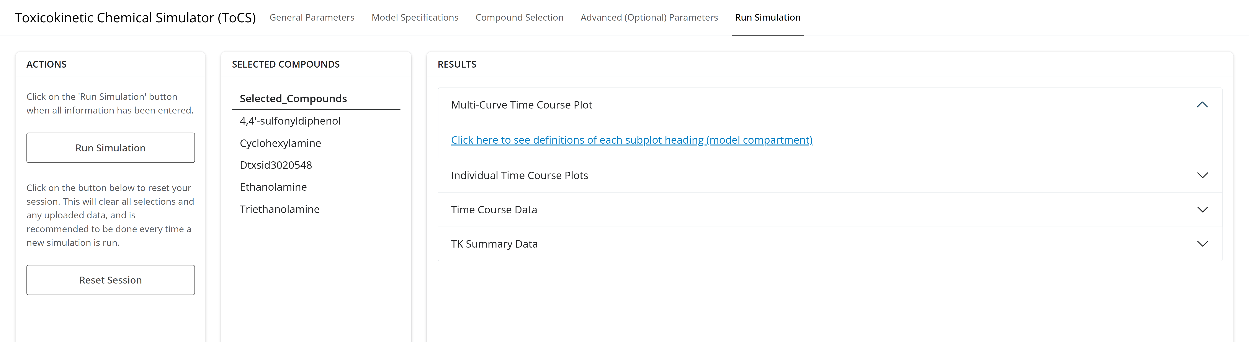
Example 1: Run Simulation Tab (Prior to Simulation Run)

Slide 36
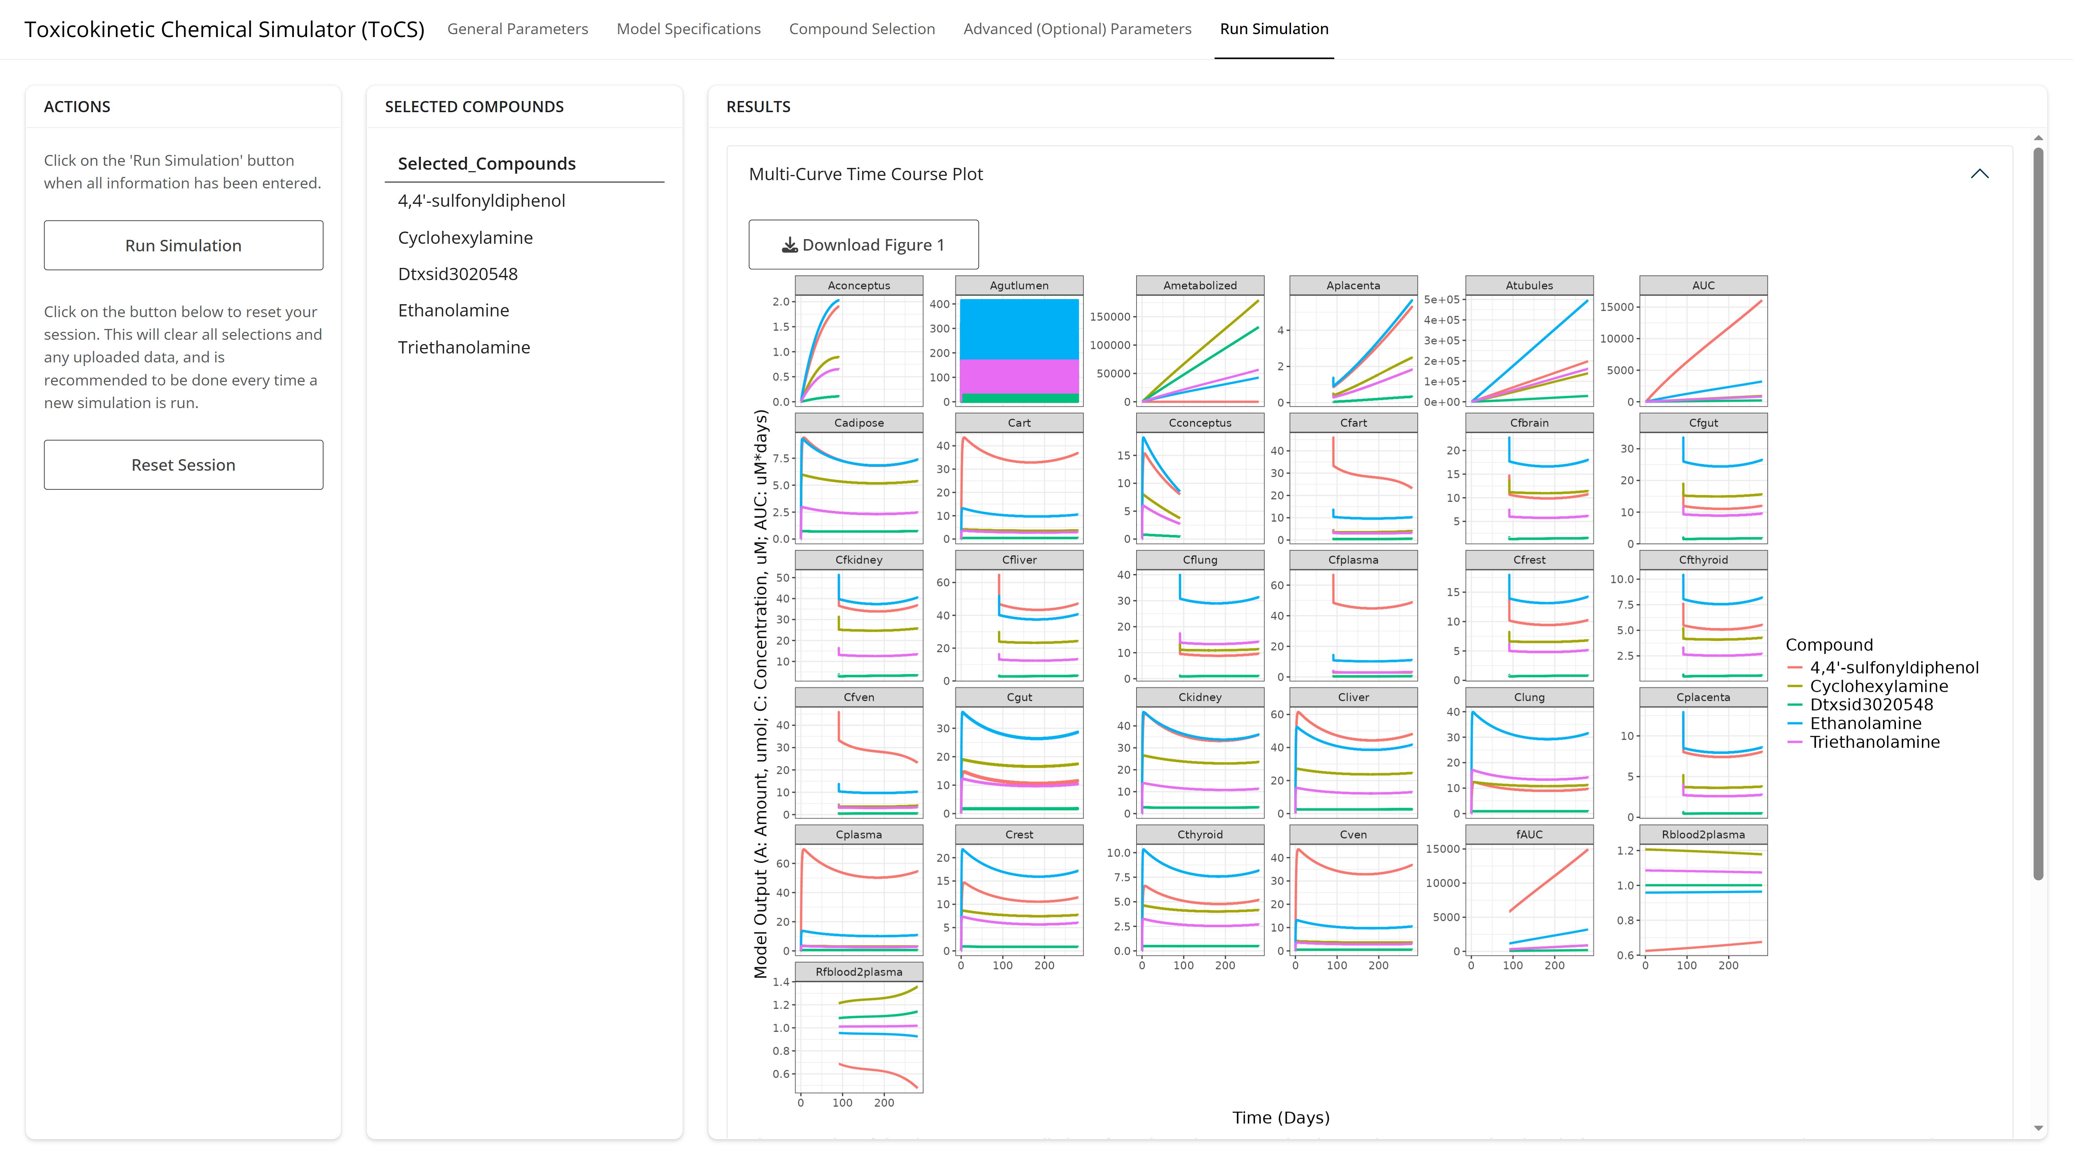
Example 1: Run Simulation Results Curves

Slide 37
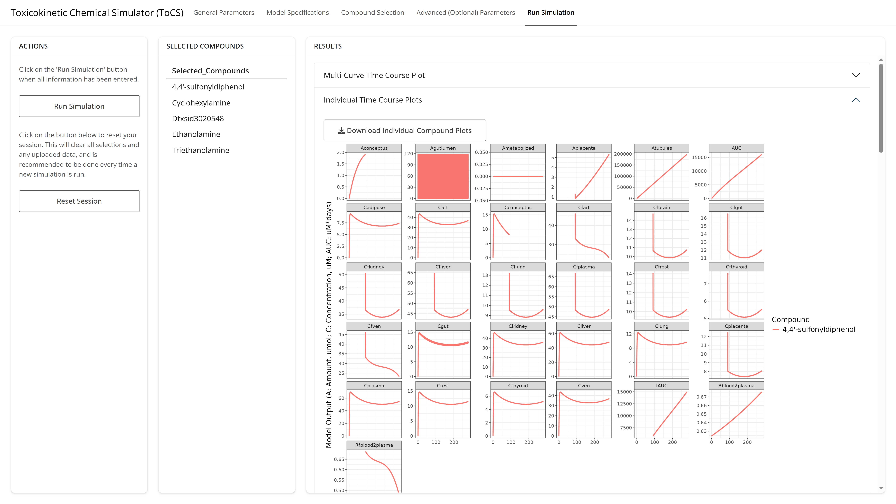
Example 1: Run Simulation Results Curves

Slide 38
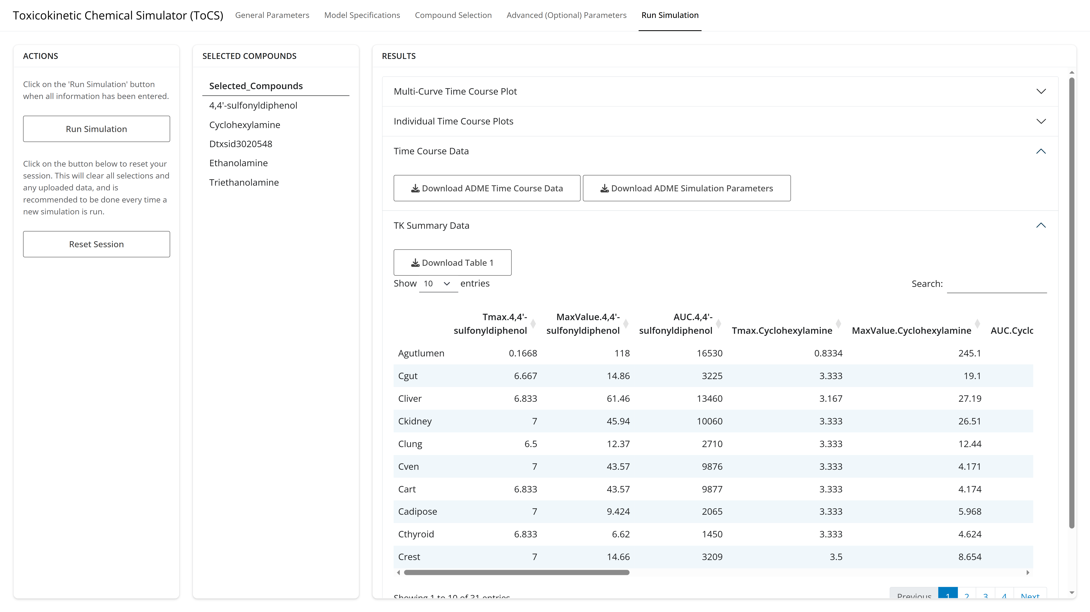
Example 1: Run Simulation Tab TK Summary Table

Slide 40
15-Minute Break

Slide 41
Session III: In Vitro to In Vivo Extrapolation (IVIVE) Module

Slide 42
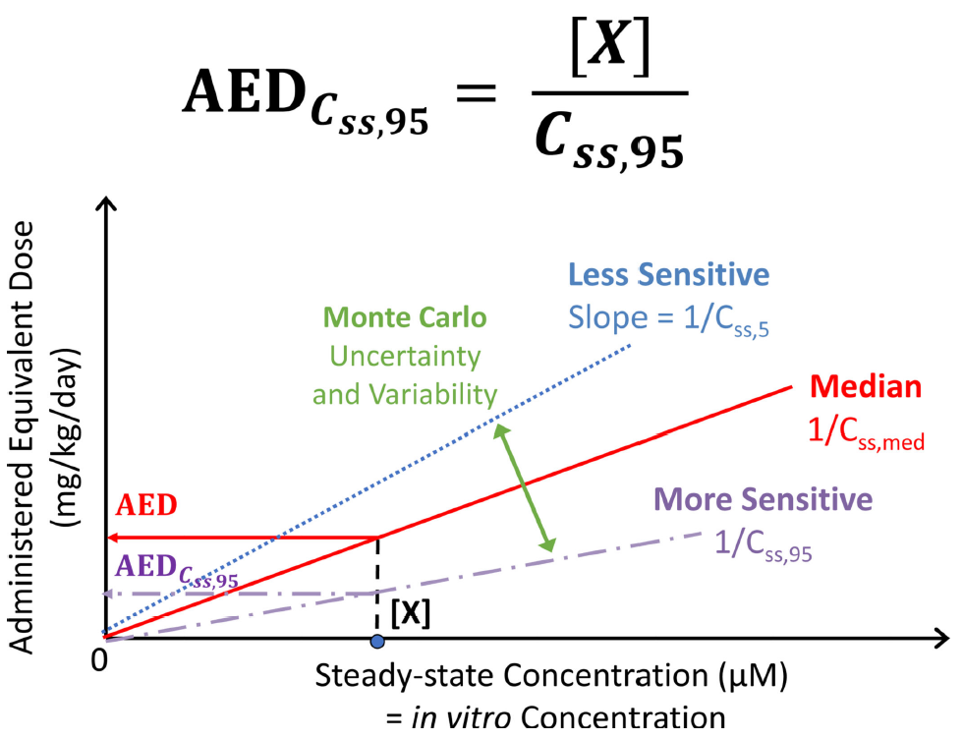
IVIVE Background
A new approach method (NAM) that uses in vitro data to predict in vivo effects of a chemical
Toxicokinetic IVIVE estimates the in vivo external dose (oral equivalent dose – OED) needed to produce an internal bioactive concentration comparable to that seen in vitro
If chemical exposure data is available, then a bioactivity exposure ratio (BER) can be calculated to estimate potential health risk of the chemical
BER < 1: A chemical may pose a health risk and should be investigated further
Breen, M., Ring, C.L., Kreutz, A., Goldsmith, M.R. and Wambaugh, J.F. (2021). High-throughput PBTK models for in vitro to in vivo extrapolation. Expert opinion on drug metabolism & toxicology

Slide 43
IVIVE Module Inputs
Required:
Species and species preferences (if applicable)
Model selection
In silico parameter preference
IVIVE conditions and output preference
Chemicals to simulate
In vitro bioactivity data
Optional:
In vivo exposure data
Bioavailability settings
Output units, concentration type (plasma, blood), and tissue compartment
Monte Carlo sampling parameters
Model calculation preferences for hepatic clearance, fraction unbound, and partition coefficients

Slide 44
Special IVIVE Options for Compound Selection in ToCS
Assumption Selection | Metabolic Clearance |  | Bioactive Concentration In Vivo |  |  | Bioactive Concentration In Vitro
 | Restrictive | Non-Restrictive* | Free Venous Plasma | Total Venous Plasma | Total Specified Tissue | Nominal | Free
NULL | X |  |  |  | X | X
Honda1 | X |  | X |  |  |  | X
Honda2 | X |  | X |  |  | X
Honda3 | X |  |  | X |  | X
Honda4 |  | X |  |  | X | X
*Protein binding NOT taken into account in liver clearance

Slide 45
In Vitro Bioactivity Data (Required for IVIVE)

Slide 46
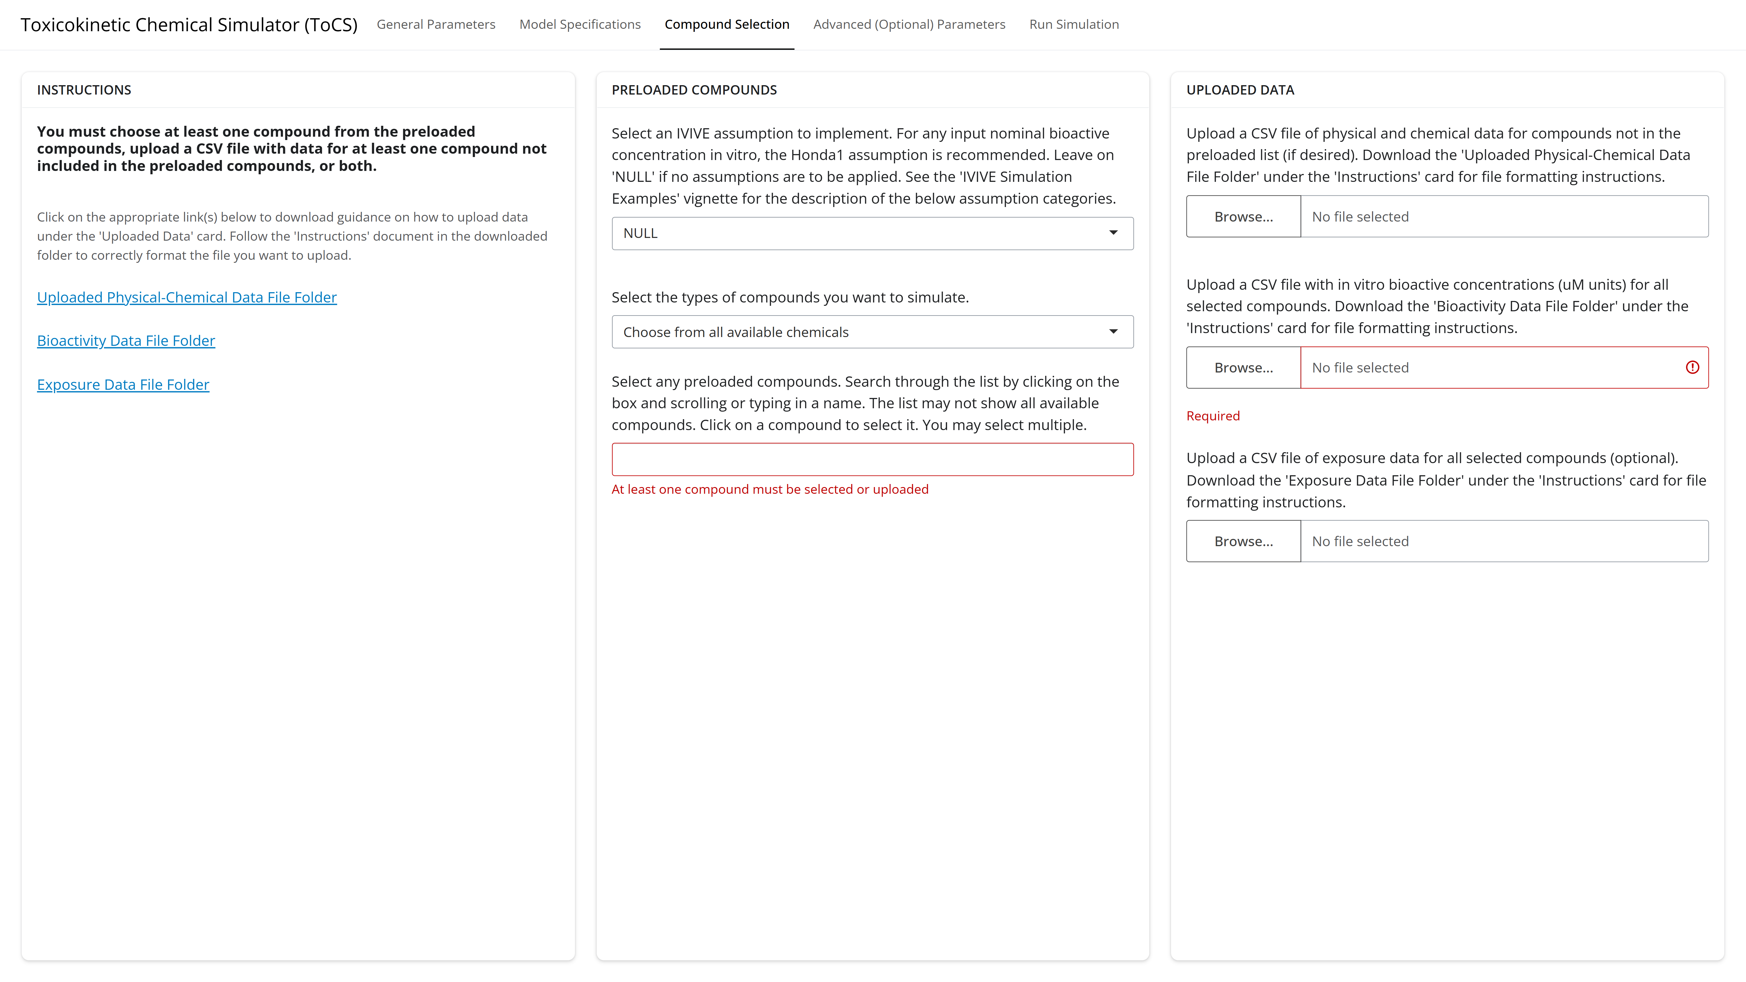
Uploading a CSV File of Bioactivity Data
Downloadable folder with instructions for uploading bioactivity data CSV
Click ‘Browse’ to find and upload the CSV file of bioactivity data

Slide 47
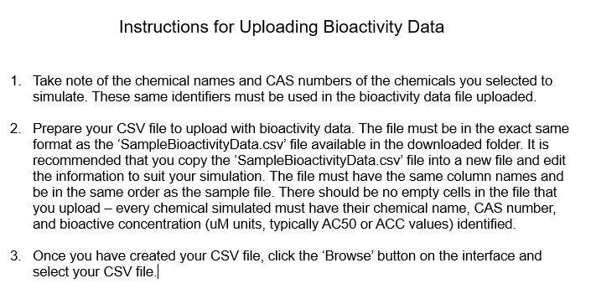
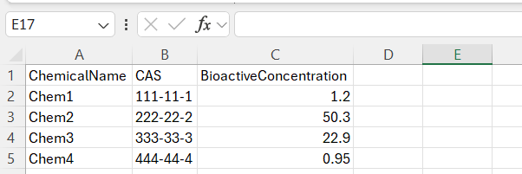
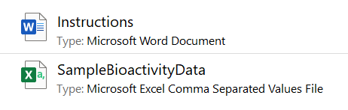
Uploading a CSV File of Bioactivity Data

Slide 48
Uploading a CSV File of Bioactivity Data
Copy and paste the SampleBioactivityData.csv file into the location of choice and rename as desired.
Leave the column headers as is. Delete the entries in all other rows.
Fill in each chemical name that you will be simulating and their corresponding CAS numbers. These identifiers MUST match the names and CAS numbers from the preloaded list or uploaded chemical data.
Fill in the in vitro bioactive concentration (in uM units) for each compound. Only one bioactive concentration per compound is permitted.
Save the CSV file.
Upload CSV file to ToCS interface.

Slide 49
In Vivo Exposure Data (Optional)
Needed to compute the bioactivity exposure ratio (BER)
Data could be retrieved from:
EPA’s CompTox Dashboard (https://comptox.epa.gov/dashboard)
NTP’s ICE platform (https://ice.ntp.niehs.nih.gov/)
FDA’s Cumulative Estimated Daily Intake (CEDI) public database (https://www.hfpappexternal.fda.gov/scripts/fdcc/index.cfm?set=CEDI)

Slide 50
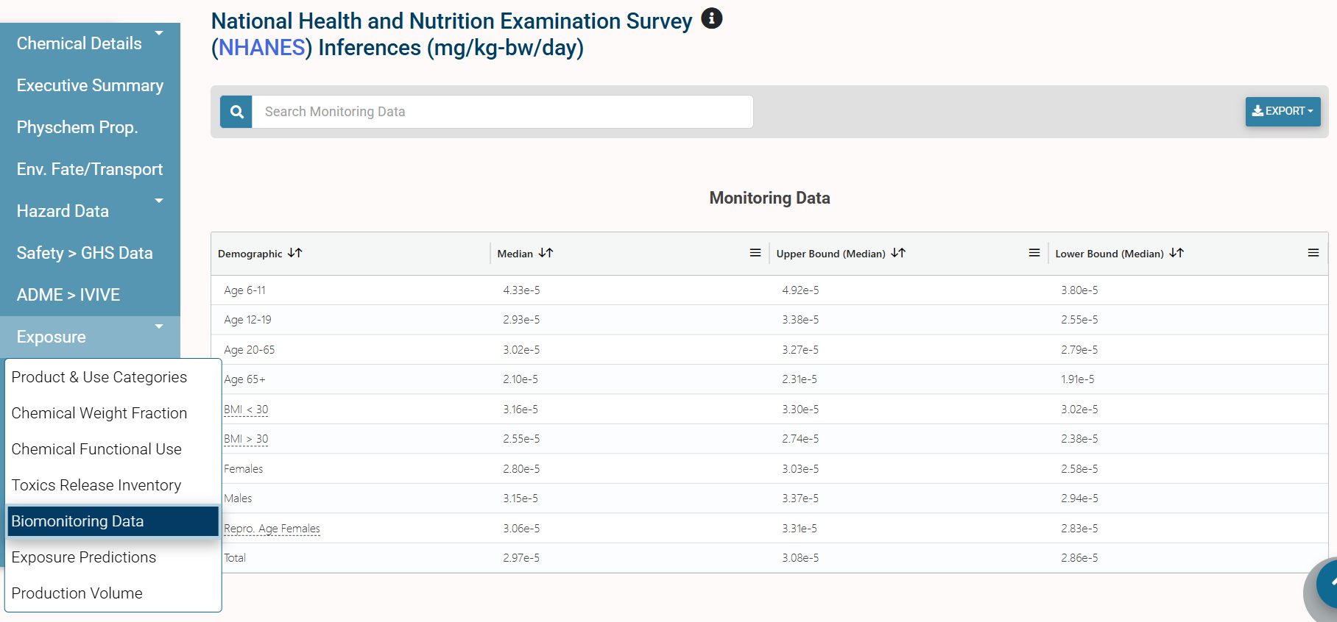
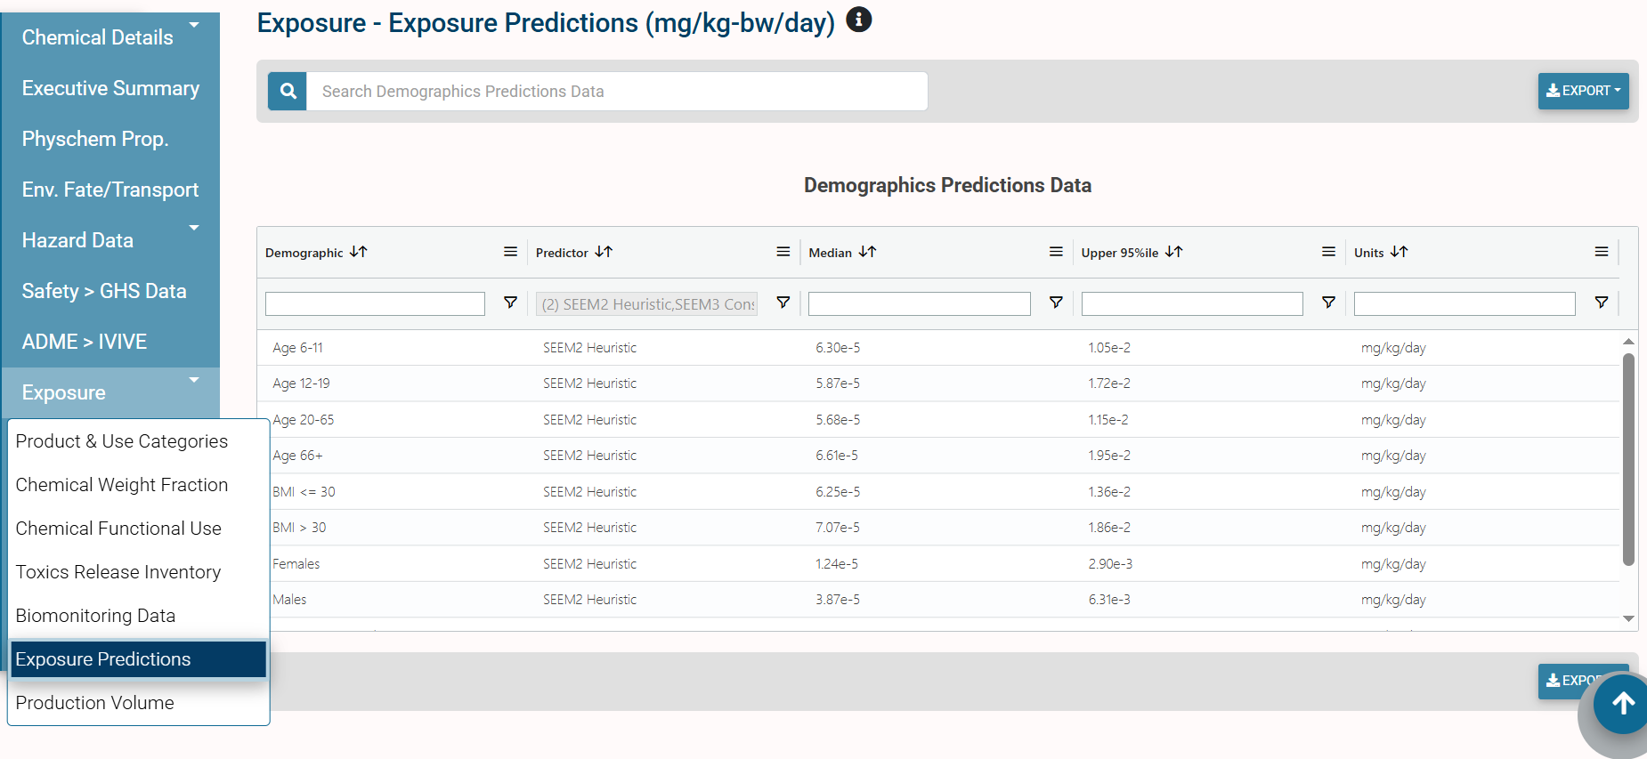
Exposure Data: EPA CompTox Dashboard
National Health and
Nutrition Examination Survey
(NHANES) Data
In Silico Predicted Data (EPA Models)

Slide 51
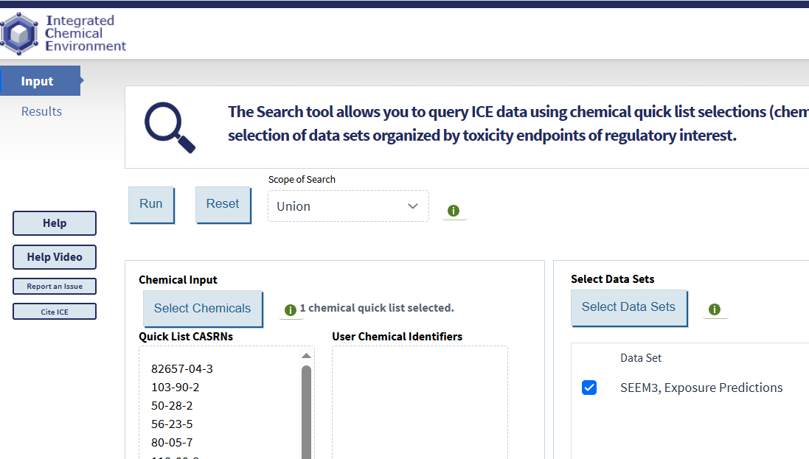
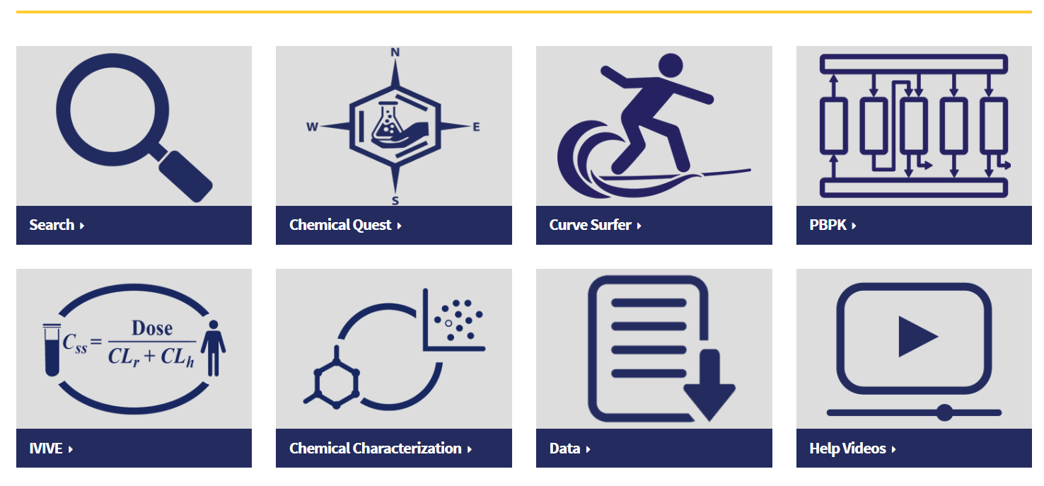
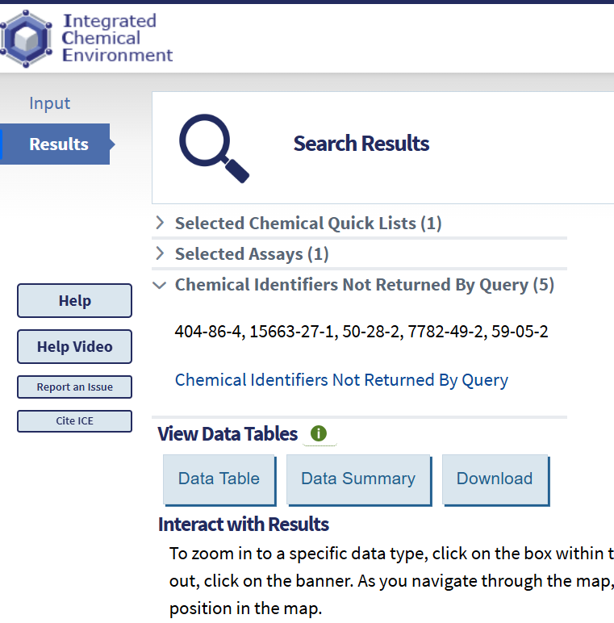
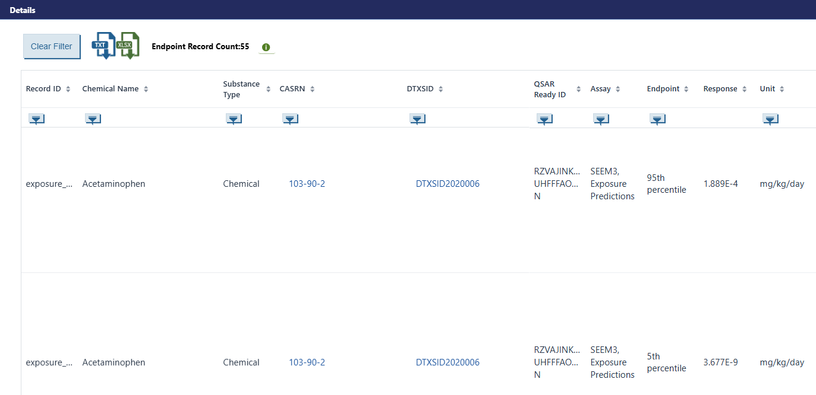
Exposure Data: NTP ICE Platform

Slide 52
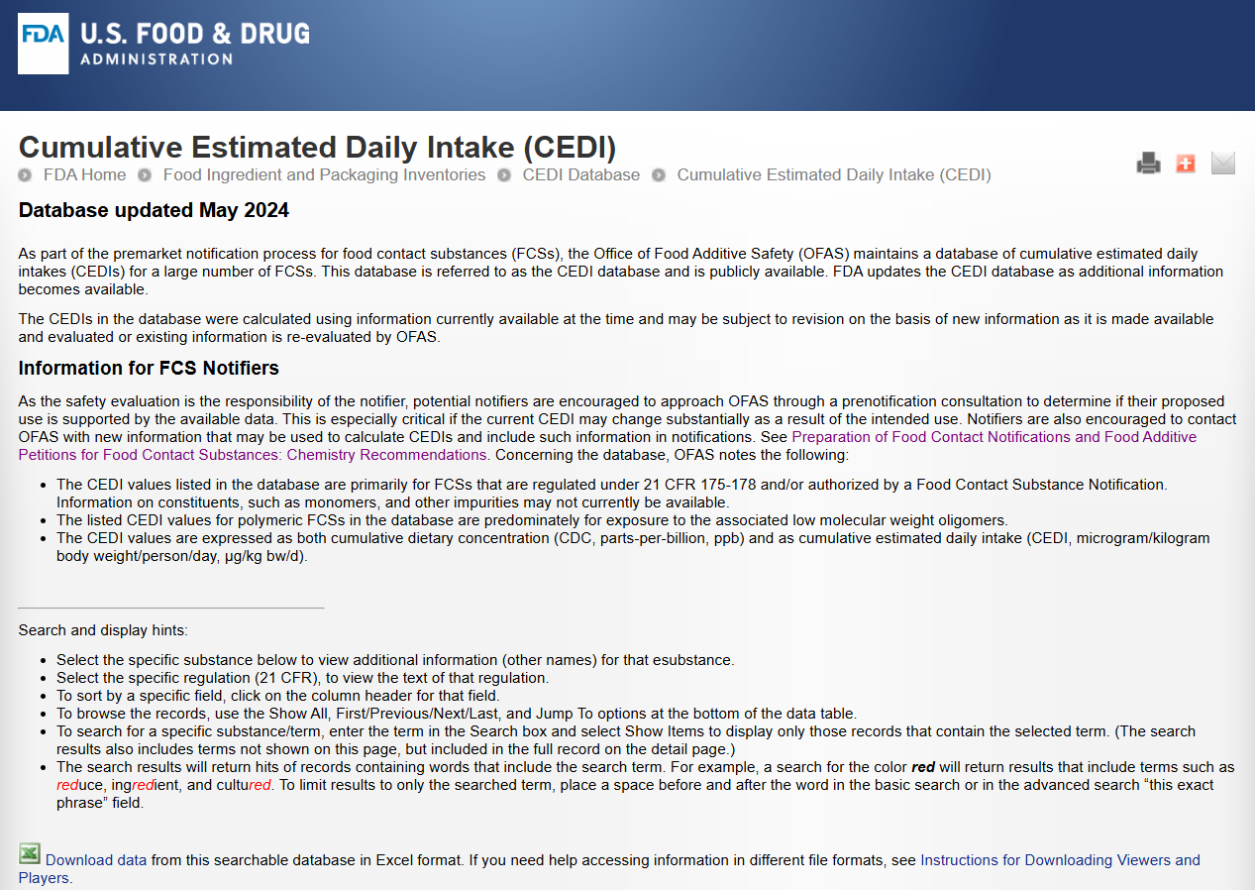
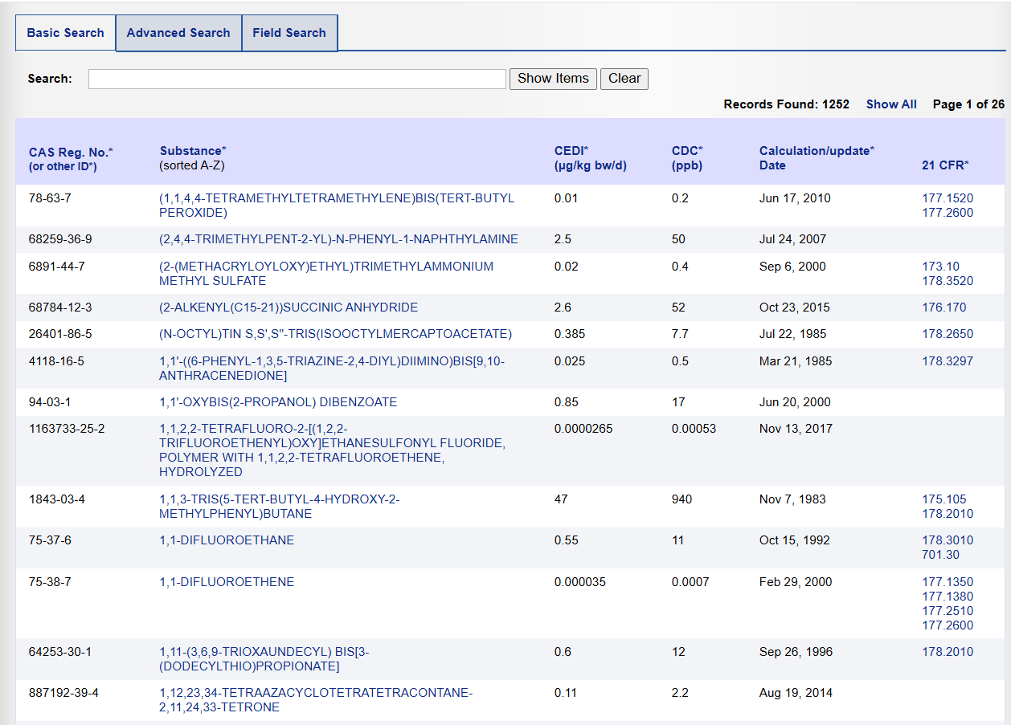
Exposure Data: FDA CEDI Database
Be careful of units! ToCS needs mg/kg-BW/day.

Slide 53
Uploading a CSV File of Exposure Data
Downloadable folder with instructions for uploading exposure data CSV
Click ‘Browse’ to find and upload the CSV file of exposure data

Slide 54
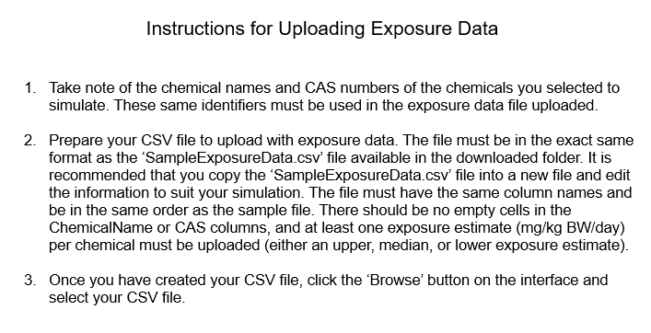
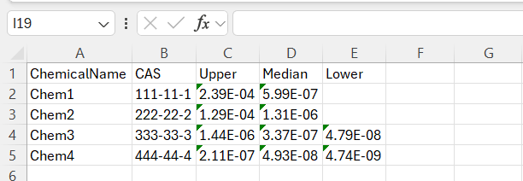
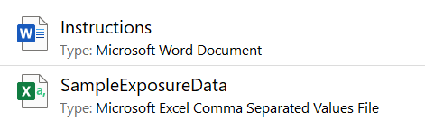
Uploading a CSV File of Exposure Data

Slide 55
Uploading a CSV File of Exposure Data
Copy and paste the SampleExposureData.csv file into the location of choice and rename as desired.
Leave the column headers as is. Delete the entries in all other rows.
Fill in each chemical name that you will be simulating and their corresponding CAS numbers. These identifiers MUST match the names and CAS numbers from the preloaded list or uploaded chemical data.
Fill in the upper, median, and lower exposure estimates (mg/kg-BW/day) as desired. There must be AT LEAST one exposure point per compound.
Save the CSV file.
Upload CSV file to ToCS interface.

Slide 56
Session IV: Steady State Concentrations and Parameter Calculations Modules

Slide 57
Steady State Concentrations Module Overview
background

Slide 58
Steady State Concentrations Module Overview
outputs

Slide 59
Steady State Concentrations Module Inputs
Required:
Species and species preferences (if applicable)
Model selection
In silico parameter preference
Dosing amount
Chemicals to simulate
Optional:
Bioavailability settings
Output units
Output units, concentration type (plasma, blood), and tissue compartment
Model calculation preferences for hepatic clearance, fraction unbound, and partition coefficients

Slide 60
Parameter Calculations Module Overview
background

Slide 61
Parameter Calculations Module Overview
outputs

Slide 62
Parameter Calculations Module Inputs
Required:
Species and species preferences (if applicable)
In silico parameter preference
Chemicals to simulate
Optional:
Bioavailability settings
Model calculation preferences for hepatic clearance, fraction unbound, and partition coefficients

Slide 63
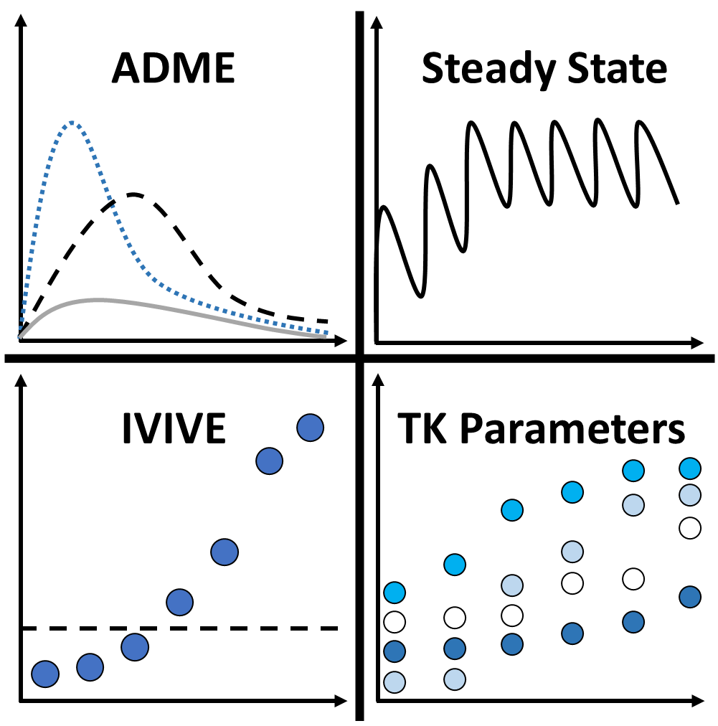
ToCS

Slide 64
ADME
Steady State
IVIVE
TK Parameters

